Slide 1












SENIOR CLASS MEETING
SENIOR CLASS MEETING

Slide 2
SENIOR FEES
SENIOR FEES
Includes:
Medallion
Diploma Cover
Cost of The Sound
Alumni Tshirt
Yard Sign
Senior Week Activities
DOES NOT INCLUDE CAP AND GOWN!!
$150

Slide 3
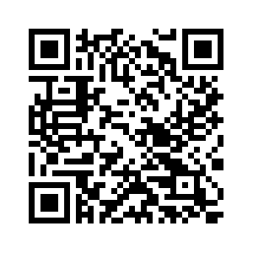
SENIOR FEES
Pay on CHS website under ONLINE PAYMENTS
This QR Code:
Or Mrs. Banks in Media Center with cash or check

Slide 4
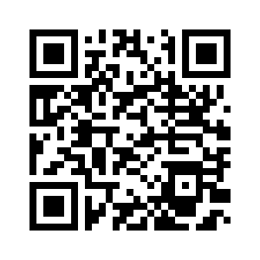
CAP AND GOWN
MUST purchase online only. Separate fee than the senior fees. $40 to start and then increases as the year goes on. ORDER EARLY!!
$40

Slide 5

SENIOR WEEK!
SENIOR WEEK!
March 9th - March 13th
A week full of FUN activities!!

Slide 6

GRAD BASH
GRAD BASH
Friday April 17, 2026
$200
Universal Studios and Islands of Adventure
Charter Bus and Food/Drink provided for the ride over.
Must have paid senior fees prior to purchasing your Grad Bash ticket.
Ticket sales are Monday February 9th- Friday February 20th on GoFan or in the Media Center with cash/check.

Slide 7
SENIOR BREAKFAST
SENIOR BREAKFAST
$25
Friday May 8, 2026
Island Way Grill
Not included in senior fees
On sale Monday, April 13th-Monday May 4th on GoFan or in the Media Center with cash/check

Slide 8
PROM
PROM
Thursday April 2, 2026
7pm-11pm
Kapok Tree
NO SCHOOL ON FRIDAY!!!

Slide 9
GRADUATION!
GRADUATION!
May 22nd
The Sound at Coachman Park
9am
NO TICKETS REQUIRED!

Slide 10
STAY CONNECTED!
STAY CONNECTED!
@ClearwaterHigh2026

Slide 11
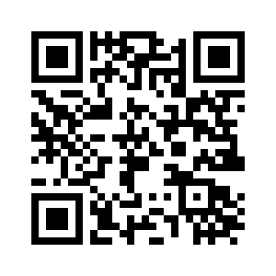
LAST NAME A-F
LAST NAME A-F

Slide 12
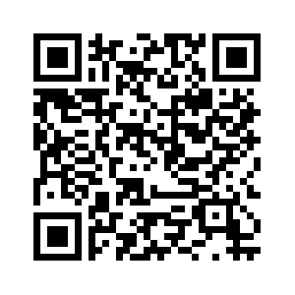
LAST NAME G-L
LAST NAME G-L

Slide 13
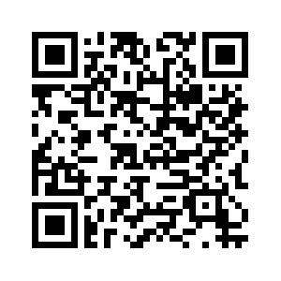
LAST NAME M-R
LAST NAME M-R

Slide 14
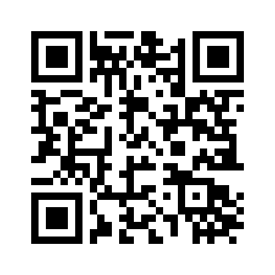
LAST NAME S-Z
LAST NAME S-Z

